Slide 1
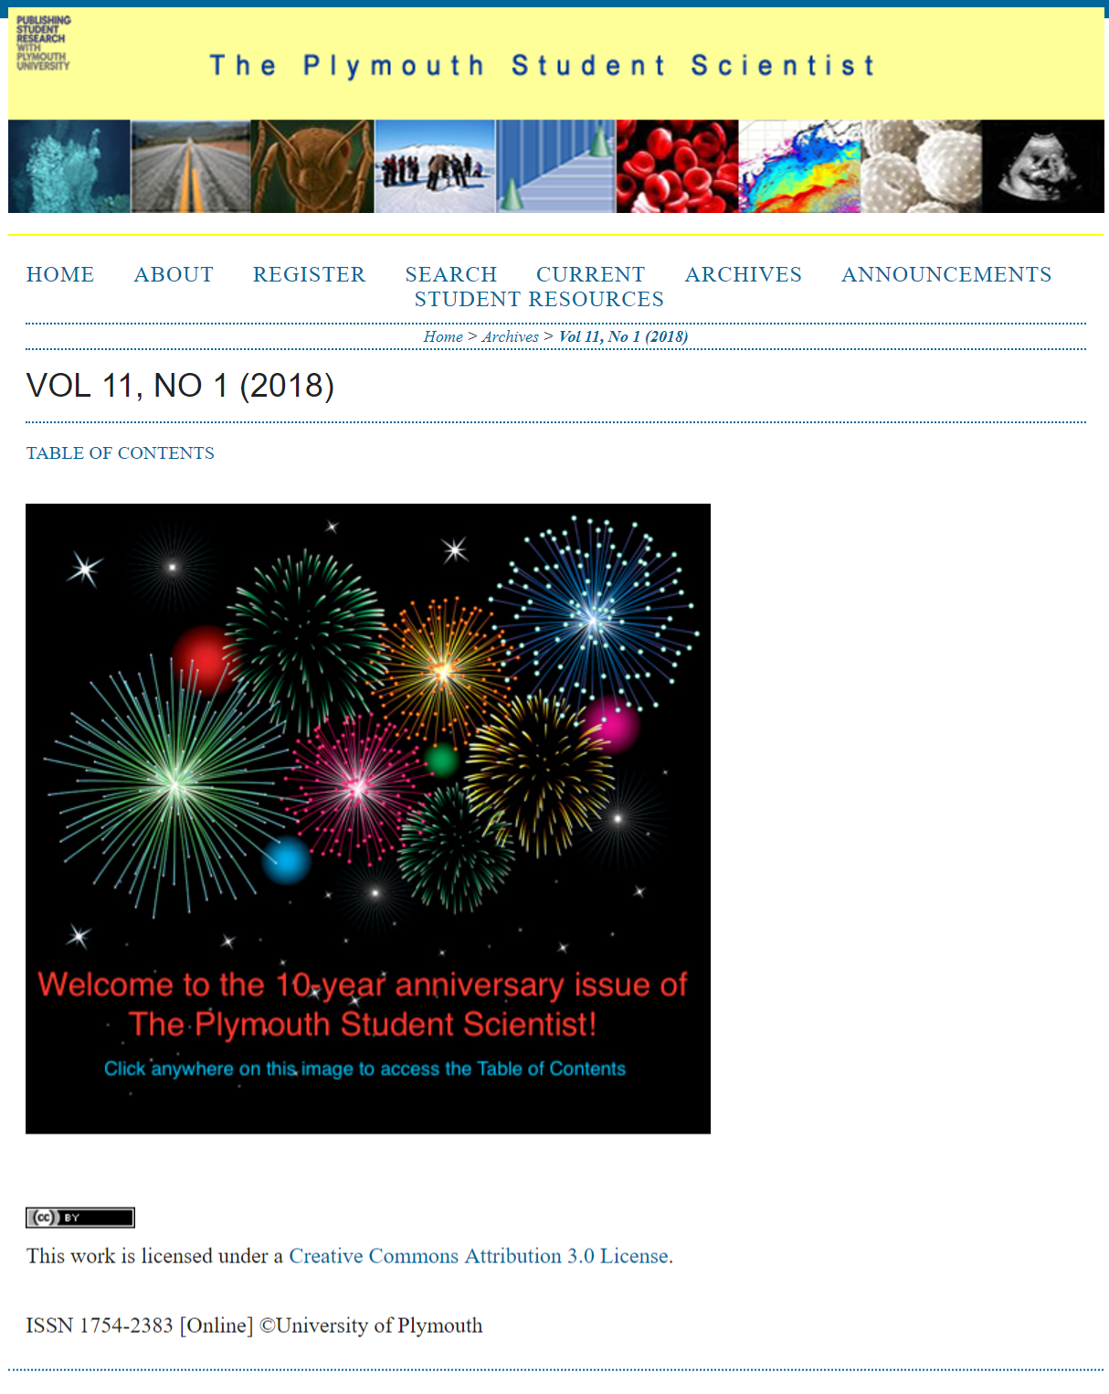
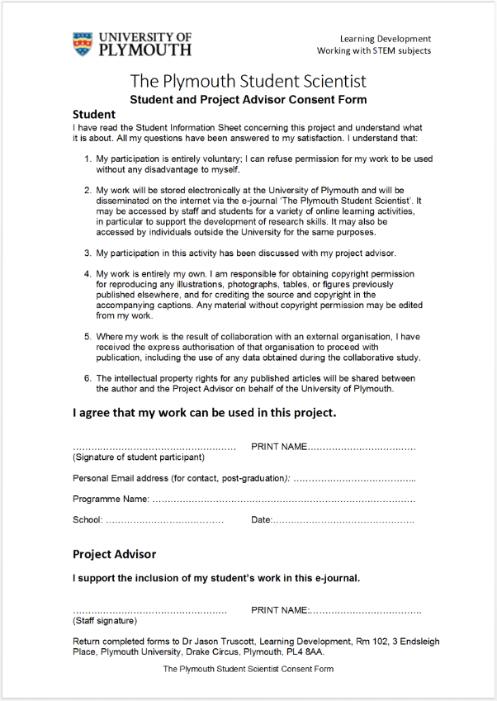

Encouraging STEM undergraduate students to make the leap into publishing research: The Plymouth Student Scientist e-journal
Visit the journal http://bit.ly/2qGWVce
Dr Jason Truscott^{i} and Dr Karen Gresty^{ii}
Learning Development, University of Plymouth, Devon, UK
Faculty of Science and Engineering, University of Plymouth, Devon, UK
Scenario
Undergraduate students in their final year of either a science, technology, engineering or mathematics (STEM) subjects often leave university without ever publishing their research. Sadly, this is often due to the swift transition from university to employment, resulting in good research sitting on shelves rather than with the wider research community.
Opportunity
The Plymouth Student Scientist e-journal (a University of Plymouth, in-house journal) allows some students who obtain a first class in their project a fast track means to publish their work in an online globally accessible journal. Not only do students have the opportunity to present their work more widely, but they also get to see what it is like to publish articles, thus experiencing core elements of the editorial process. They are then better equipped to publish within other journals in the future. Many researchers are already aware that sharing research can lead to enhanced professional profiles and even collaborate with other institutions, which has already happened for some students publishing in this journal.
Contact:
Jason Truscott
1. Expression of interest
2. Fill out student consent form
3. Student receives a 1st for project
4. Format article
5. Published in journal
Benefits to students and staff
Research indicates that undergraduate students who share their research experiences and practices with peers helps others starting their own research projects (Stanford et al., 2017; Zimbardi & Myatt, 2014), this journal can help in this respect.
Project supervisors get a mention in the acknowledgments.
It showcases best practice in disciplines.
It encourages dialogue on research practices and approach, which can then be taken into postgraduate research or perhaps industry.
Students are incredibly excited when they are offered an opportunity to publish, a ‘valued welcome reward’ for their efforts (Gresty & Edwards-Jones, 2012).
Helps sets goals for those wishing to push that 2:1 average a little further.
Many would agree that the perceived ‘quality of research’ can vary depending on who you speak with in academia, however, students possessing the ability to apply themselves critically is something everyone agrees (Brew & Mantai, 2017). This is where Learning Development can help. We can provide bespoke sessions that target specific academic skills, prior to starting their research projects, or even during.
See back of consent form
http://bit.ly/2Ir5Fu0
Figure 1: Five steps to publishing: The Plymouth Student Scientist eJournal
Process
There are five simple steps to publishing in this journal (Figure 1), all with the view of reducing the amount of work for busy project supervisors. Although (2) student consent is required before we can publish, it is for supervisor/s and project student to decide whether the original report is submitted as is, or whether further revisions are made, taking into account marker comments. Other than that, we only require some basic formatting and the article is then published.
So what do students really think? Examples taken from Gresty & Edwards-Jones (2012, p. 157)
‘It just made me feel good to have it published. That it was a good bit of work and other people can see that as well. I’m actually quite proud of it.’
‘I think it’s a very good opportunity for students to be able to do this because I think a lot of students don’t think they could ever get their work published.’
References
Brew, A. & Mantai, L. (2017) 'Academics’ perceptions of the challenges and barriers to implementing research-based experiences for undergraduates'. Teaching in Higher Education, 22 (5), pp. 551-568.
Gresty, K. A. & Edwards‐Jones, A. (2012) 'Experiencing research‐informed teaching from the student perspective: Insights from developing an undergraduate e‐journal'. British Journal of Educational Technology, 43 (1), pp. 153-162.
Stanford, J. S., Rocheleau, S. E., Smith, K. P. W. & Mohan, J. (2017) 'Early undergraduate research experiences lead to similar learning gains for STEM and Non-STEM undergraduates'. Studies in Higher Education, 42 (1), pp. 115-129.
Zimbardi, K. & Myatt, P. (2014) 'Embedding undergraduate research experiences within the curriculum: a cross-disciplinary study of the key characteristics guiding implementation'. Studies in Higher Education, 39 (2), pp. 233-250.
Learning Development: http://bit.ly/2LR0zJL
Faculty of Science and Engineering: http://bit.ly/2sQFTcc
Notes:
This poster is set at A1 which is half the size of A0, which was adequate for the conference attended. However, if it was created in A0, it is less of an issue to print down to A1. Printing from A1 to A0 is a different problem, as you might find that images start to look blurry as the quality deteriorates when printing larger.
Remember to save as a PDF before sending to print if sending to a printing services as it ensures your poster will look exactly as you intended.

